Slide 1
CHEMDU · COMMUNITY CHEMISTRY · LEVEL 2 ADVANCED
LECTURE 10
Gas Laws (Advanced)
PV = nRT and the math of gases
chemdu.org | An advanced module

Slide 2
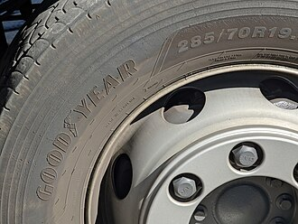
CHEMDU · LEVEL 2 · ADVANCED
L2-10: Gas Laws (Advanced)
OPENING
Three things that get bigger when warm
▸ Car tire bulges in summer.
▸ Sealed chip bag puffs up on a plane.
▸ Aerosol can in a hot car can explode.
▸ All explained by PV = nRT.
Tire · chip bag · aerosol can
chemdu.org
Slide 2 / 11

Slide 3
CHEMDU · LEVEL 2 · ADVANCED
L2-10: Gas Laws (Advanced)
IDEAL GAS LAW
PV = nRT
▸ PV = nRT}
▸ P = pressure (atm)
▸ V = volume (L)
▸ n = moles
▸ R = 0.0821 L·atm / (mol·K)
▸ T = absolute temperature (Kelvin!)
chemdu.org
Slide 3 / 11

Slide 4
CHEMDU · LEVEL 2 · ADVANCED
L2-10: Gas Laws (Advanced)
TEMPERATURE IN KELVIN
Why we use the absolute scale
▸ T(K) = T(°C) + 273.15
▸ No negative temperatures (absolute zero = 0 K = -273.15 °C)
▸ Volume and pressure formulas all break down with negative T
▸ ALWAYS convert to Kelvin before using PV = nRT
chemdu.org
Slide 4 / 11

Slide 5
CHEMDU · LEVEL 2 · ADVANCED
L2-10: Gas Laws (Advanced)
PRESSURE UNITS
Three you'll see
Unit | Value at sea level | Where used
atm | 1.00 | Chemistry
psi | 14.7 | Tires, plumbing
mmHg | 760 | Medicine, vacuum
kPa | 101.3 | Engineering
mbar | 1013 | Weather
chemdu.org
Slide 5 / 11

Slide 6
CHEMDU · LEVEL 2 · ADVANCED
L2-10: Gas Laws (Advanced)
✦ WORKED EXAMPLE 1
Find moles (n)
?
V = 2.00 L, T = 25 °C = 298 K, P = 1.00 atm. Find n.
1
PV = nRT → n = PV / RT
2
n = (1.00 × 2.00) / (0.0821 × 298)
3
n = 2.00 / 24.47
4
n = 0.0817 mol
✦ ANSWER
0.0817 mol
chemdu.org
Slide 6 / 11

Slide 7
CHEMDU · LEVEL 2 · ADVANCED
L2-10: Gas Laws (Advanced)
✦ WORKED EXAMPLE 2
Find pressure (P)
?
V = 5.00 L, n = 2.00 mol, T = 300 K. Find P.
1
PV = nRT → P = nRT / V
2
P = (2.00 × 0.0821 × 300) / 5.00
3
P = 49.26 / 5.00
4
P = 9.85 atm
✦ ANSWER
9.85 atm
chemdu.org
Slide 7 / 11

Slide 8
CHEMDU · LEVEL 2 · ADVANCED
L2-10: Gas Laws (Advanced)
✦ WORKED EXAMPLE 3
Combined gas law
?
A tire reads 32.0 psi at 20°C (293 K). After driving in summer, T = 50°C (323 K). New pressure?
1
P₁V₁/T₁ = P₂V₂/T₂ (V constant)
2
P₁/T₁ = P₂/T₂
3
P₂ = P₁ × T₂/T₁
4
P₂ = 32.0 × 323/293
5
P₂ ≈ 35.3 psi
✦ ANSWER
35.3 psi
chemdu.org
Slide 8 / 11

Slide 9
CHEMDU · LEVEL 2 · ADVANCED
L2-10: Gas Laws (Advanced)
DALTON'S LAW
Partial pressures add up
▸ {P_total = P₁ + P₂ + P₃ + ...}
▸ Air is 78% N₂ + 21% O₂ + 1% Ar
▸ At 1.00 atm: P_O₂ = 0.21 atm
▸ In scuba diving: deep water raises ALL partial pressures
▸ Above ~1.4 atm O₂ → oxygen toxicity (seizures)
chemdu.org
Slide 9 / 11

Slide 10
CHEMDU · LEVEL 2 · ADVANCED
L2-10: Gas Laws (Advanced)
✦ WORKED EXAMPLE 4
Scuba diving partial pressure
?
At 30 m underwater, total pressure = 4.0 atm. Air is 21% O₂. Find P_O₂.
1
P_O₂ = total × fraction_O₂
2
P_O₂ = 4.0 × 0.21
3
P_O₂ = 0.84 atm
4
(Safe — toxicity above 1.4 atm)
✦ ANSWER
0.84 atm
chemdu.org
Slide 10 / 11

Slide 11
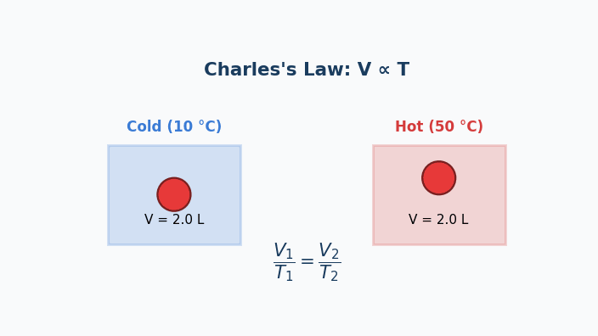
Animation — Charles's Law
Same balloon, two temperatures. Volume rises in step with temperature.

Slide 12
CHEMDU · LEVEL 2 · ADVANCED
L2-10: Gas Laws (Advanced)
WRAP-UP
Gas-law tool kit
CONCEPT / FORMULA | WHAT IT MEANS / USE
PV = nRT | Ideal gas law (always works)
T must be in Kelvin | T(K) = T(°C) + 273.15
R = 0.0821 L·atm/mol·K | Use this with atm and L
P₁V₁/T₁ = P₂V₂/T₂ | Combined gas law (n constant)
P_total = ΣPᵢ | Dalton's law of partial pressures
chemdu.org
Slide 11 / 11

