Slide 1
CHEMDU · COMMUNITY CHEMISTRY · LEVEL 2 ADVANCED
LECTURE 9
Kinetics & Equilibrium (Advanced)
Rate laws, half-life, and equilibrium constants
chemdu.org | An advanced module

Slide 2
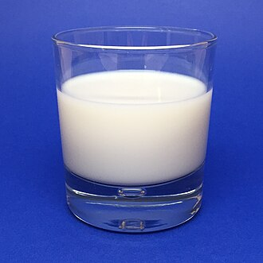
CHEMDU · LEVEL 2 · ADVANCED
L2-9: Kinetics & Equilibrium (Advanced)
OPENING
Two glasses of water, two tea bags
▸ Hot water → uniformly tea-colored in ~1 minute.
▸ Cold water → still pale after 10 minutes.
▸ Same chemistry. Different speed.
▸ Today: the math of reaction rate and equilibrium.
Hot vs cold tea diffusion
chemdu.org
Slide 2 / 11

Slide 3
CHEMDU · LEVEL 2 · ADVANCED
L2-9: Kinetics & Equilibrium (Advanced)
RATE OF REACTION
How fast concentration changes
▸ {Rate = Δ[concentration] / Δt}
▸ Units: M/s (molarity per second)
▸ Rate is positive (always)
▸ 4 levers control it: temperature, concentration, surface area, catalyst
chemdu.org
Slide 3 / 11

Slide 4
CHEMDU · LEVEL 2 · ADVANCED
L2-9: Kinetics & Equilibrium (Advanced)
✦ WORKED EXAMPLE 1
Reaction rate from data
?
Alka-Seltzer in water: [CO₂] goes from 0.00 M to 0.05 M in 10 seconds. Find the rate.
1
Rate = Δ[CO₂] / Δt
2
Rate = (0.05 - 0.00) / 10
3
Rate = 0.005 M/s
✦ ANSWER
0.005 M/s
chemdu.org
Slide 4 / 11

Slide 5
CHEMDU · LEVEL 2 · ADVANCED
L2-9: Kinetics & Equilibrium (Advanced)
RATE LAW
rate = k[A]ⁿ
▸ rate = k × [reactant]ⁿ
▸ k = rate constant (depends on temperature)
▸ n = order of reaction (typically 0, 1, or 2)
▸ $BLU{First-order} (n=1): rate ∝ [A] — like radioactive decay
▸ $BLU{Second-order} (n=2): rate ∝ [A]² — many enzyme reactions
chemdu.org
Slide 5 / 11

Slide 6
CHEMDU · LEVEL 2 · ADVANCED
L2-9: Kinetics & Equilibrium (Advanced)
HALF-LIFE FOR FIRST-ORDER
t₁/₂ = 0.693 / k
▸ t₁/₂ = 0.693 / k
▸ Half-life is CONSTANT for first-order reactions
▸ Doesn't depend on starting amount
▸ Used in radioactive decay, drug clearance, food spoilage
chemdu.org
Slide 6 / 11

Slide 7
CHEMDU · LEVEL 2 · ADVANCED
L2-9: Kinetics & Equilibrium (Advanced)
✦ WORKED EXAMPLE 2
Half-life from rate constant
?
A first-order reaction has k = 0.1386 hr⁻¹. Find the half-life.
1
t₁/₂ = 0.693 / k
2
t₁/₂ = 0.693 / 0.1386
3
t₁/₂ = 5.00 hours
✦ ANSWER
5.00 hours
chemdu.org
Slide 7 / 11

Slide 8
CHEMDU · LEVEL 2 · ADVANCED
L2-9: Kinetics & Equilibrium (Advanced)
✦ WORKED EXAMPLE 3
Carbon-14 dating
?
C-14 has t₁/₂ = 5,730 years. After 17,190 years, how much of a 100 g sample remains?
1
n = time / t₁/₂
2
n = 17,190 / 5,730 = 3 half-lives
3
Remaining = 100 × (1/2)³
4
Remaining = 100 × 0.125
5
Remaining = 12.5 g
✦ ANSWER
12.5 g
chemdu.org
Slide 8 / 11

Slide 9
CHEMDU · LEVEL 2 · ADVANCED
L2-9: Kinetics & Equilibrium (Advanced)
EQUILIBRIUM
Forward and backward rates equal
▸ Reactions can go BOTH ways: A + B ⇌ C + D
▸ At equilibrium, both rates are equal — but NOT zero
▸ {K = [products] / [reactants]} (raised to coefficients)
▸ K >> 1}: products favored
▸ {K << 1}: reactants favored
▸ {K ≈ 1}: roughly equal
chemdu.org
Slide 9 / 11

Slide 10
CHEMDU · LEVEL 2 · ADVANCED
L2-9: Kinetics & Equilibrium (Advanced)
✦ WORKED EXAMPLE 4
Le Chatelier's direction
?
For H₂ + I₂ ⇌ 2 HI, K = 16. If [H₂] = [I₂] = 1.0 M and [HI] = 2.5 M, which way will the reaction shift?
1
Q = [HI]² / ([H₂][I₂])
2
Q = (2.5)² / (1.0 × 1.0)
3
Q = 6.25
4
Q (6.25) < K (16)
5
∴ Reaction shifts RIGHT (forward) until Q = K.
✦ ANSWER
Shift forward (→)
chemdu.org
Slide 10 / 11

Slide 11
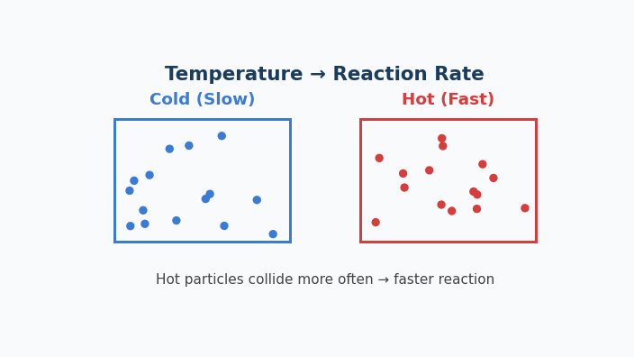
Animation — Temperature & Reaction Rate
Cold particles drift; hot particles zip. More collisions → faster reaction.

Slide 12
CHEMDU · LEVEL 2 · ADVANCED
L2-9: Kinetics & Equilibrium (Advanced)
WRAP-UP
Rate / equilibrium toolkit
CONCEPT / FORMULA | WHAT IT MEANS / USE
Rate = Δ[c] / Δt | Reaction rate
rate = k[A]ⁿ | Rate law
t₁/₂ = 0.693 / k | First-order half-life
K = [P] / [R] | Equilibrium constant
Le Chatelier | System opposes change
chemdu.org
Slide 11 / 11

