Slide 1
CHEMDU · COMMUNITY CHEMISTRY · LEVEL 2 ADVANCED
LECTURE 8
Thermodynamics (Advanced)
Specific heat, calorimetry, and Hess's Law
chemdu.org | An advanced module

Slide 2
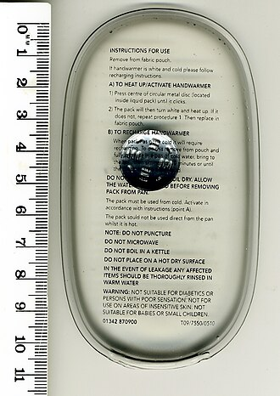
CHEMDU · LEVEL 2 · ADVANCED
L2-8: Thermodynamics (Advanced)
OPENING
Why does aluminum heat faster than water?
▸ A pot of water takes ~4 minutes to boil; an aluminum pan heats in ~30 seconds.
▸ Same heat input. Different result.
▸ Specific heat — the property that explains it.
Boiling pot · microwave · cold pack
chemdu.org
Slide 2 / 11

Slide 3
CHEMDU · LEVEL 2 · ADVANCED
L2-8: Thermodynamics (Advanced)
HEAT VS TEMPERATURE
Different things
▸ Heat (q) = total thermal energy
▸ Big swimming pool at 25°C has more HEAT than a coffee at 80°C
▸ Temperature (T) = average energy per particle
▸ Coffee at 80°C has higher TEMPERATURE
▸ You can boil a thimble fast (low heat); pool would take a year (high heat)
chemdu.org
Slide 3 / 11

Slide 4
CHEMDU · LEVEL 2 · ADVANCED
L2-8: Thermodynamics (Advanced)
SPECIFIC HEAT (C)
Energy to raise 1 g by 1 °C
Substance | c (J/g·°C) | What it means
Water | 4.184 | Hard to heat or cool — climate stabilizer
Aluminum | 0.900 | Heats and cools fast — cookware
Iron | 0.450 | Even faster — cast-iron pans
Copper | 0.385 | Fastest of the common metals
Sand/dirt | ~0.84 | Why deserts cool fast at night
chemdu.org
Slide 4 / 11

Slide 5
CHEMDU · LEVEL 2 · ADVANCED
L2-8: Thermodynamics (Advanced)
HEAT EQUATION
q = m × c × ΔT
▸ q = m × c × ΔT
▸ q = heat (Joules)
▸ m = mass (grams)
▸ c = specific heat (J/g·°C)
▸ ΔT = temperature change (°C, final − initial)
chemdu.org
Slide 5 / 11

Slide 6
CHEMDU · LEVEL 2 · ADVANCED
L2-8: Thermodynamics (Advanced)
✦ WORKED EXAMPLE 1
Heat 250 g water from 22 °C to 100 °C
?
How much heat is needed?
1
q = m × c × ΔT
2
q = 250 × 4.184 × (100 - 22)
3
q = 250 × 4.184 × 78
4
q = 81,588 J
5
q ≈ 81.6 kJ
✦ ANSWER
81.6 kJ
chemdu.org
Slide 6 / 11

Slide 7
CHEMDU · LEVEL 2 · ADVANCED
L2-8: Thermodynamics (Advanced)
✦ WORKED EXAMPLE 2
Compare aluminum vs water (same mass, same ΔT)
?
500 g of each, heat both from 25 °C to 200 °C. How much heat?
1
Aluminum: q = 500 × 0.900 × 175 = 78,750 J
2
Water: q = 500 × 4.184 × 175 = 366,100 J
3
Water needs 4.6× more heat for the same temperature jump.
4
∴ Aluminum heats faster — same energy goes further.
✦ ANSWER
Al: 78,750 J · H₂O: 366,100 J
chemdu.org
Slide 7 / 11

Slide 8
CHEMDU · LEVEL 2 · ADVANCED
L2-8: Thermodynamics (Advanced)
✦ WORKED EXAMPLE 3
Calorimetry — find unknown specific heat
?
A 50 g hot metal at 100°C is dropped into 200 g of water at 20°C. Final temp = 24°C. What is c_metal?
1
Heat lost by metal = Heat gained by water
2
m_M × c_M × ΔT_M = -m_W × c_W × ΔT_W
3
50 × c_M × (24-100) = -200 × 4.184 × (24-20)
4
50 × c_M × (-76) = -3347.2
5
c_M = 3347.2 / 3800
✦ ANSWER
0.881 J/g·°C
chemdu.org
Slide 8 / 11

Slide 9
CHEMDU · LEVEL 2 · ADVANCED
L2-8: Thermodynamics (Advanced)
ENTHALPY (ΔH)
Heat at constant pressure
▸ $YEL{ΔH < 0} → exothermic (heat OUT, gets hot)
▸ $YEL{ΔH > 0} → endothermic (heat IN, gets cold)
▸ Combustion: ΔH = -890 kJ/mol for methane
▸ Photosynthesis: ΔH = +2802 kJ/mol (uses sunlight)
▸ Tabulated for thousands of reactions
chemdu.org
Slide 9 / 11

Slide 10
CHEMDU · LEVEL 2 · ADVANCED
L2-8: Thermodynamics (Advanced)
HESS'S LAW
Add reaction enthalpies
▸ You can add up steps to find ΔH for a complex reaction
▸ Example: C → CO → CO₂ (carbon to carbon dioxide via CO)
▸ C + ½ O₂ → CO ΔH = -110.5 kJ
▸ CO + ½ O₂ → CO₂ ΔH = -283.0 kJ
▸ $YEL{Total: C + O₂ → CO₂ ΔH = -393.5 kJ}
▸ Same as direct combustion of carbon — independent of path.
chemdu.org
Slide 10 / 11

Slide 11
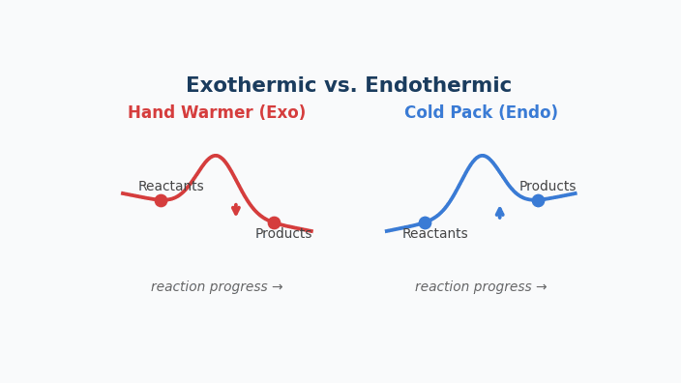
Animation — Exothermic vs. Endothermic
Hand warmer releases heat (curve down); cold pack absorbs heat (curve up).

Slide 12
CHEMDU · LEVEL 2 · ADVANCED
L2-8: Thermodynamics (Advanced)
WRAP-UP
Thermo formulas
CONCEPT / FORMULA | WHAT IT MEANS / USE
q = mcΔT | Heat for a temperature change
Specific heat c | Material property (J/g·°C)
Calorimetry | Heat lost = heat gained
ΔH < 0 | Exothermic
ΔH > 0 | Endothermic
Hess's Law | Add ΔH along any path
chemdu.org
Slide 11 / 11

