Slide 1
CHEMDU · COMMUNITY CHEMISTRY · LEVEL 2 ADVANCED
LECTURE 7
Acids & Bases (Advanced)
pH math, titration, and buffer chemistry
chemdu.org | An advanced module

Slide 2
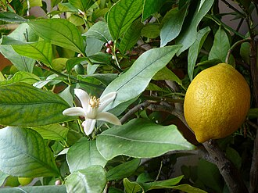
CHEMDU · LEVEL 2 · ADVANCED
L2-7: Acids & Bases (Advanced)
OPENING
pH is a logarithmic scale
▸ pH = -log[H⁺] — that "log" makes huge differences in small numbers.
▸ pH 4 vinegar is 1,000× more acidic than pH 7 water.
▸ Today: do the math, predict pH, and understand titration.
Lemon · bleach · pool kit
chemdu.org
Slide 2 / 11

Slide 3
CHEMDU · LEVEL 2 · ADVANCED
L2-7: Acids & Bases (Advanced)
PH FORMULAS
Two equations to know
▸ $YEL{pH = -log[H⁺]}
▸ $YEL{[H⁺] = 10^(-pH)}
▸ [H⁺] is the molar concentration of hydrogen ions
▸ Pure water at 25°C: [H⁺] = 10⁻⁷ M → pH = 7
chemdu.org
Slide 3 / 11

Slide 4
CHEMDU · LEVEL 2 · ADVANCED
L2-7: Acids & Bases (Advanced)
✦ WORKED EXAMPLE 1
[H⁺] → pH
?
A solution has [H⁺] = 0.01 M. What is its pH?
1
pH = -log[H⁺]
2
pH = -log(0.01)
3
pH = -log(10⁻²)
4
pH = -(-2)
5
pH = 2 (acidic — like lemon juice)
✦ ANSWER
pH = 2
chemdu.org
Slide 4 / 11

Slide 5
CHEMDU · LEVEL 2 · ADVANCED
L2-7: Acids & Bases (Advanced)
✦ WORKED EXAMPLE 2
[H⁺] → pH (decimal)
?
A solution has [H⁺] = 2.5 × 10⁻⁴ M. What is the pH?
1
pH = -log(2.5 × 10⁻⁴)
2
pH = -[log(2.5) + log(10⁻⁴)]
3
pH = -[0.398 + (-4)]
4
pH = -[-3.602]
5
pH ≈ 3.60
✦ ANSWER
pH = 3.60
chemdu.org
Slide 5 / 11

Slide 6
CHEMDU · LEVEL 2 · ADVANCED
L2-7: Acids & Bases (Advanced)
✦ WORKED EXAMPLE 3
pH → [H⁺]
?
A solution has pH = 4.5. What is [H⁺]?
1
[H⁺] = 10^(-pH)
2
[H⁺] = 10^(-4.5)
3
[H⁺] = 3.16 × 10⁻⁵ M
✦ ANSWER
3.16 × 10⁻⁵ M
chemdu.org
Slide 6 / 11

Slide 7
CHEMDU · LEVEL 2 · ADVANCED
L2-7: Acids & Bases (Advanced)
STRONG VS WEAK
Dissociation = % of acid molecules that release H⁺
Acid | Type | % dissociated | 0.01 M → pH
HCl (hydrochloric) | Strong | 100% | 2.0
HNO₃ (nitric) | Strong | 100% | 2.0
H₂SO₄ (sulfuric) | Strong | 100% | 1.7
CH₃COOH (vinegar) | Weak | ~1% | 3.4
H₂CO₃ (carbonic, soda) | Weak | ~0.1% | 4.2
chemdu.org
Slide 7 / 11

Slide 8
CHEMDU · LEVEL 2 · ADVANCED
L2-7: Acids & Bases (Advanced)
TITRATION
Find unknown concentration
▸ Add a strong base (NaOH, known M) drop-by-drop until indicator changes
▸ At neutralization: moles acid = moles base
▸ $YEL{M_acid × V_acid = M_base × V_base} (for 1:1 reactions)
▸ Used in pool chemistry, blood tests, medicine production
chemdu.org
Slide 8 / 11

Slide 9
CHEMDU · LEVEL 2 · ADVANCED
L2-7: Acids & Bases (Advanced)
✦ WORKED EXAMPLE 4
Vinegar titration
?
25.0 mL vinegar requires 40.0 mL of 0.100 M NaOH to neutralize. Find the molarity of the vinegar.
1
M_acid × V_acid = M_base × V_base
2
M × 25.0 = 0.100 × 40.0
3
M = 4.00 / 25.0
4
M_acid = 0.160 M acetic acid
✦ ANSWER
0.160 M
chemdu.org
Slide 9 / 11

Slide 10
CHEMDU · LEVEL 2 · ADVANCED
L2-7: Acids & Bases (Advanced)
BUFFERS
Resist pH change
▸ Mix of weak acid + its conjugate base (or weak base + its conjugate acid)
▸ Soaks up incoming H⁺ or OH⁻ → pH stays nearly constant
▸ Your blood is buffered at pH 7.4 by H₂CO₃ ⇌ HCO₃⁻
▸ Pool water uses sodium bicarbonate as buffer
▸ Antacids work because they raise stomach pH from ~2 to ~3-4
chemdu.org
Slide 10 / 11

Slide 11
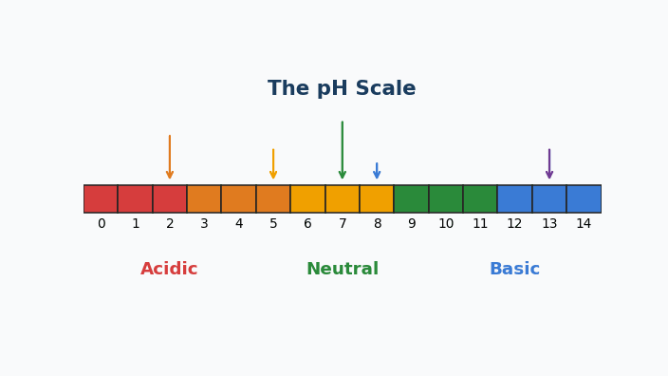
Animation — The pH Scale
0–14 color scale with everyday items pinned by pH. Red = acid, purple = base.

Slide 12
CHEMDU · LEVEL 2 · ADVANCED
L2-7: Acids & Bases (Advanced)
WRAP-UP
Acid–base toolkit
CONCEPT / FORMULA | WHAT IT MEANS / USE
pH = -log[H⁺] | Convert concentration to pH
[H⁺] = 10⁻ᵖᴴ | Convert pH back to concentration
M_a V_a = M_b V_b | Titration (1:1 reaction)
Buffer | Weak acid/base pair → resists pH change
Strong vs weak | 100% dissociation vs ~1%
chemdu.org
Slide 11 / 11

