Slide 1
CHEMDU · COMMUNITY CHEMISTRY · LEVEL 2 ADVANCED
LECTURE 6
Solutions & Solubility (Advanced)
Molarity, dilution, and concentration math
chemdu.org | An advanced module

Slide 2
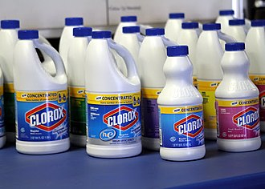
CHEMDU · LEVEL 2 · ADVANCED
L2-6: Solutions & Solubility (Advanced)
OPENING
Bleach bottle says "1/3 cup per gallon"
▸ Why exactly 1/3 cup? Why not 1 cup?
▸ Concentration matters — too dilute = useless; too strong = dangerous.
▸ Today: how to calculate any concentration, dilution, and ppm.
Bleach bottle dilution label
chemdu.org
Slide 2 / 10

Slide 3
CHEMDU · LEVEL 2 · ADVANCED
L2-6: Solutions & Solubility (Advanced)
MOLARITY (M)
The chemist's favorite unit
▸ $YEL{M = moles of solute / liters of solution}
▸ "0.5 M NaCl" = 0.5 moles of NaCl per liter of solution
▸ Used in lab work, medicine dosing, environmental monitoring
▸ 1 M = 1 mol/L = 1 millimole/mL
chemdu.org
Slide 3 / 10

Slide 4
CHEMDU · LEVEL 2 · ADVANCED
L2-6: Solutions & Solubility (Advanced)
✦ WORKED EXAMPLE 1
Make 0.200 M NaCl solution
?
How many grams of NaCl to make 0.500 L of 0.200 M? (M=58.44)
1
moles = M × V
2
moles = 0.200 mol/L × 0.500 L = 0.100 mol
3
grams = moles × M = 0.100 × 58.44
4
grams = 5.84 g NaCl
✦ ANSWER
5.84 g NaCl
chemdu.org
Slide 4 / 10

Slide 5
CHEMDU · LEVEL 2 · ADVANCED
L2-6: Solutions & Solubility (Advanced)
✦ WORKED EXAMPLE 2
Find molarity
?
Dissolve 34.2 g sucrose (M=342) in 0.250 L water. What's the molarity?
1
moles = grams ÷ M
2
moles = 34.2 ÷ 342 = 0.100 mol
3
M = moles ÷ volume
4
M = 0.100 ÷ 0.250
5
M = 0.400 mol/L
✦ ANSWER
0.400 M
chemdu.org
Slide 5 / 10

Slide 6
CHEMDU · LEVEL 2 · ADVANCED
L2-6: Solutions & Solubility (Advanced)
DILUTION FORMULA
M₁V₁ = M₂V₂
▸ Moles before = moles after (you only change the volume)
▸ $YEL{M₁V₁ = M₂V₂}
▸ Easier: skip the moles step entirely
▸ Used every time you mix a concentrate (bleach, juice, lab acids)
chemdu.org
Slide 6 / 10

Slide 7
CHEMDU · LEVEL 2 · ADVANCED
L2-6: Solutions & Solubility (Advanced)
✦ WORKED EXAMPLE 3
Diluting bleach
?
Stock bleach is 5.0 M. How much do you need to make 1.0 L of 0.50 M cleaning solution?
1
M₁V₁ = M₂V₂
2
5.0 × V₁ = 0.50 × 1.0
3
V₁ = 0.50 / 5.0
4
V₁ = 0.10 L = 100 mL of stock
5
Add water up to 1.0 L total.
✦ ANSWER
100 mL of stock
chemdu.org
Slide 7 / 10

Slide 8
CHEMDU · LEVEL 2 · ADVANCED
L2-6: Solutions & Solubility (Advanced)
SOLUBILITY RULES
Will it dissolve?
Cation | Anion | Soluble?
Na⁺, K⁺, NH₄⁺ | anything | Always yes
Anything | NO₃⁻ | Always yes
Ag⁺, Pb²⁺ | Cl⁻, Br⁻, I⁻ | No (precipitates)
Ag⁺, Pb²⁺, Ca²⁺ | SO₄²⁻ | Often no
Anything | OH⁻ (except 1, 2) | Usually no
chemdu.org
Slide 8 / 10

Slide 9
CHEMDU · LEVEL 2 · ADVANCED
L2-6: Solutions & Solubility (Advanced)
PARTS PER MILLION
For trace amounts
▸ ppm = mg solute / kg solution (≈ mg / L for water)
▸ Used for trace contaminants (lead in water, fluoride)
▸ Example: 2 ppm lead = 2 mg lead in every 1 kg of water
▸ EPA action level for lead in drinking water: 15 ppb (0.015 ppm)
chemdu.org
Slide 9 / 10

Slide 10
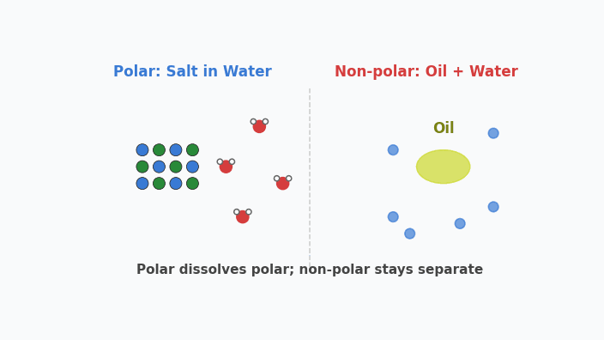
Animation — Like Dissolves Like
Water (polar) pulls salt apart. Oil (non-polar) refuses to mix with water.

Slide 11
CHEMDU · LEVEL 2 · ADVANCED
L2-6: Solutions & Solubility (Advanced)
WRAP-UP
Concentration tools
CONCEPT / FORMULA | WHAT IT MEANS / USE
M = moles / L | Molarity definition
M₁V₁ = M₂V₂ | Dilution formula
ppm | mg per kg (or mg per L for water)
% by mass | g solute / 100 g solution
Solubility rules | Predict precipitates
chemdu.org
Slide 10 / 10

