Slide 1
CHEMDU · COMMUNITY CHEMISTRY · LEVEL 2 ADVANCED
LECTURE 4
Chemical Reactions (Advanced)
Five reaction types and the algebra of balancing
chemdu.org | An advanced module

Slide 2
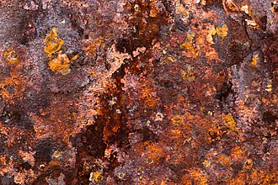
CHEMDU · LEVEL 2 · ADVANCED
L2-4: Chemical Reactions (Advanced)
OPENING
Four everyday reactions
▸ Baking soda + vinegar fizz (double displacement).
▸ Burning candle (combustion).
▸ Rusty nail (synthesis / oxidation).
▸ Battery makes current (single displacement / redox).
▸ All five reaction types follow the same conservation laws.
Baking soda · candle · rust · battery
chemdu.org
Slide 2 / 10

Slide 3
CHEMDU · LEVEL 2 · ADVANCED
L2-4: Chemical Reactions (Advanced)
REVIEW
Conservation of mass
▸ Reactants → Products. Atoms in = atoms out.
▸ Equation must BALANCE: same atoms on both sides.
▸ Five major reaction types: synthesis, decomposition, single displacement, double displacement, combustion
chemdu.org
Slide 3 / 10

Slide 4
CHEMDU · LEVEL 2 · ADVANCED
L2-4: Chemical Reactions (Advanced)
FIVE REACTION TYPES
Identify by pattern
Type | Pattern | Example
Synthesis | A + B → AB | 4 Fe + 3 O₂ → 2 Fe₂O₃ (rust)
Decomposition | AB → A + B | 2 H₂O₂ → 2 H₂O + O₂
Single displacement | A + BC → AC + B | Zn + 2 HCl → ZnCl₂ + H₂
Double displacement | AB + CD → AD + CB | NaHCO₃ + acid → CO₂ + H₂O + salt
Combustion | fuel + O₂ → CO₂ + H₂O | CH₄ + 2 O₂ → CO₂ + 2 H₂O
chemdu.org
Slide 4 / 10

Slide 5
CHEMDU · LEVEL 2 · ADVANCED
L2-4: Chemical Reactions (Advanced)
BALANCING — 5-STEP METHOD
How to balance any equation
▸ 1. Write the unbalanced equation with correct formulas
▸ 2. Count atoms of each element on both sides
▸ 3. Balance the most-uncommon element first
▸ 4. Balance H last, O second-to-last
▸ 5. Check by re-counting all atoms
chemdu.org
Slide 5 / 10

Slide 6
CHEMDU · LEVEL 2 · ADVANCED
L2-4: Chemical Reactions (Advanced)
✦ WORKED EXAMPLE 1
Balance: CH₄ + O₂ → CO₂ + H₂O
?
Methane combustion. Find the smallest whole-number coefficients.
1
CH₄ + O₂ → CO₂ + H₂O
2
Carbon: 1 = 1 ✓
3
Hydrogen: 4 vs 2 → put 2 in front of H₂O
4
CH₄ + O₂ → CO₂ + 2 H₂O
5
Oxygen: 2 vs 4 → put 2 in front of O₂
✦ ANSWER
CH₄ + 2 O₂ → CO₂ + 2 H₂O
chemdu.org
Slide 6 / 10

Slide 7
CHEMDU · LEVEL 2 · ADVANCED
L2-4: Chemical Reactions (Advanced)
✦ WORKED EXAMPLE 2
Balance: Fe + O₂ → Fe₂O₃
?
Iron rusting. Smallest whole numbers.
1
Fe + O₂ → Fe₂O₃
2
Iron: 1 vs 2 → put 2 in front of Fe
3
2 Fe + O₂ → Fe₂O₃
4
Oxygen: 2 vs 3 — need a multiple of 6
5
4 Fe + 3 O₂ → 2 Fe₂O₃ (now Fe: 4=4, O: 6=6)
✦ ANSWER
4 Fe + 3 O₂ → 2 Fe₂O₃
chemdu.org
Slide 7 / 10

Slide 8
CHEMDU · LEVEL 2 · ADVANCED
L2-4: Chemical Reactions (Advanced)
✦ WORKED EXAMPLE 3
Balance: C₃H₈ + O₂ → CO₂ + H₂O
?
Propane combustion (gas grills).
1
C₃H₈ + O₂ → CO₂ + H₂O
2
Carbon: 3 vs 1 → 3 in front of CO₂
3
C₃H₈ + O₂ → 3 CO₂ + H₂O
4
Hydrogen: 8 vs 2 → 4 in front of H₂O
5
C₃H₈ + O₂ → 3 CO₂ + 4 H₂O
✦ ANSWER
C₃H₈ + 5 O₂ → 3 CO₂ + 4 H₂O
chemdu.org
Slide 8 / 10

Slide 9
CHEMDU · LEVEL 2 · ADVANCED
L2-4: Chemical Reactions (Advanced)
NET IONIC EQUATIONS
Strip out the spectators
▸ Many reactions in water involve ions (charged particles)
▸ Spectator ions are on BOTH sides — they don't do anything
▸ Cancel them out → write the NET ionic equation
▸ Ex: AgNO₃ + NaCl → AgCl ↓ + NaNO₃
▸ Ions: Ag⁺ + NO₃⁻ + Na⁺ + Cl⁻ → AgCl + Na⁺ + NO₃⁻
▸ Net ionic: $YEL{Ag⁺ + Cl⁻ → AgCl ↓}
chemdu.org
Slide 9 / 10

Slide 10
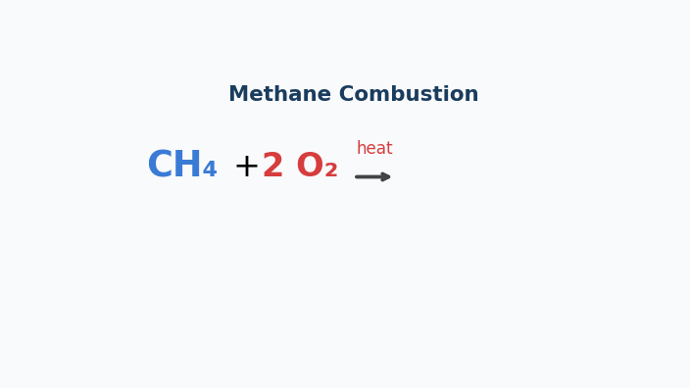
Animation — Methane Combustion
Reactants (CH₄ + 2 O₂) fade out; products (CO₂ + 2 H₂O) fade in. Mass balanced.

Slide 11
CHEMDU · LEVEL 2 · ADVANCED
L2-4: Chemical Reactions (Advanced)
WRAP-UP
Reaction toolkit
CONCEPT / FORMULA | WHAT IT MEANS / USE
5 types | Synthesis, decomp, single, double, combustion
Balancing rule | Coefficients only — never change formulas
Conservation | Atoms in = atoms out
Net ionic equation | Cancel spectators; show what really happens
CH₄ + 2 O₂ → CO₂ + 2 H₂O | Natural gas combustion
chemdu.org
Slide 10 / 10

