Slide 1
CHEMDU · COMMUNITY CHEMISTRY · LEVEL 2 ADVANCED
LECTURE 3
Chemical Bonding (Advanced)
Lewis structures, VSEPR, and predicting molecular shape
chemdu.org | An advanced module

Slide 2
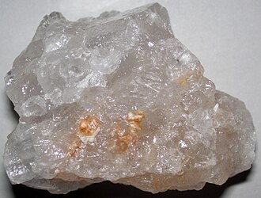
CHEMDU · LEVEL 2 · ADVANCED
L2-3: Chemical Bonding (Advanced)
OPENING
Three molecules, three different shapes
▸ Snowflake — six-fold symmetry comes from H-bonds in ice (hexagonal).
▸ Dry ice — solid CO₂ that sublimates (linear, non-polar).
▸ Vinegar + oil — they don't mix (polar vs. non-polar).
▸ Today: how to predict any molecule's shape from its formula.
Snowflake · dry ice · oil/water
chemdu.org
Slide 2 / 11

Slide 3
CHEMDU · LEVEL 2 · ADVANCED
L2-3: Chemical Bonding (Advanced)
REVIEW
Bonding refresher
▸ Atoms bond to fill outer shells (octet rule)
▸ $BLU{Ionic} — full electron transfer (NaCl)
▸ $BLU{Covalent} — sharing electrons (H₂O, CO₂)
▸ $BLU{Metallic} — pooled "sea" of electrons (Cu, Fe)
▸ This lecture focuses on covalent bonds and shape.
chemdu.org
Slide 3 / 11

Slide 4
CHEMDU · LEVEL 2 · ADVANCED
L2-3: Chemical Bonding (Advanced)
LEWIS STRUCTURES
Five-step method
▸ 1. Count total valence electrons (sum from all atoms)
▸ 2. Pick a central atom (least electronegative, except H)
▸ 3. Draw single bonds from center to surrounding atoms
▸ 4. Distribute remaining electrons as lone pairs (octets first)
▸ 5. If short, convert lone pairs to double/triple bonds
chemdu.org
Slide 4 / 11

Slide 5
CHEMDU · LEVEL 2 · ADVANCED
L2-3: Chemical Bonding (Advanced)
⚛ EXAMPLE 1
Water (H₂O) — bent shape
⛓ MOLECULE PROFILE
Name
Water
Formula
H₂O
· ·
· ·
Atoms
3
O
Bonds
2
H
H
Lone pairs
2
Shape
Bent (104.5°)
▸ 8 total electrons; 2 bonds + 2 lone pairs on O → bent shape, polar molecule.
chemdu.org
Slide 5 / 11

Slide 6
CHEMDU · LEVEL 2 · ADVANCED
L2-3: Chemical Bonding (Advanced)
⚛ EXAMPLE 2
Carbon dioxide (CO₂) — linear
⛓ MOLECULE PROFILE
Name
Carbon dioxide
Formula
CO₂
· ·
· ·
Atoms
3
O
C
O
Bonds
2
· ·
· ·
Lone pairs
4
Shape
Linear (180°)
▸ 16 total electrons; 2 double bonds, no lone pairs on C → linear shape, non-polar.
chemdu.org
Slide 6 / 11

Slide 7
CHEMDU · LEVEL 2 · ADVANCED
L2-3: Chemical Bonding (Advanced)
⚛ EXAMPLE 3
Methane (CH₄) — tetrahedral
⛓ MOLECULE PROFILE
Name
Methane
H
H
Formula
CH₄
Atoms
5
C
Bonds
4
Lone pairs
0
H
H
Shape
Tetrahedral (109.5°)
▸ 8 total electrons; 4 bonds, no lone pairs → tetrahedral, non-polar.
chemdu.org
Slide 7 / 11

Slide 8
CHEMDU · LEVEL 2 · ADVANCED
L2-3: Chemical Bonding (Advanced)
VSEPR SHAPES
Electron groups → predict shape
Bonded | Lone pairs | Shape | Angle | Example
2 | 0 | Linear | 180° | CO₂
3 | 0 | Trigonal planar | 120° | BF₃
2 | 1 | Bent | ~118° | SO₂
4 | 0 | Tetrahedral | 109.5° | CH₄
3 | 1 | Trigonal pyramid | ~107° | NH₃
2 | 2 | Bent | ~104.5° | H₂O
chemdu.org
Slide 8 / 11

Slide 9
CHEMDU · LEVEL 2 · ADVANCED
L2-3: Chemical Bonding (Advanced)
BOND POLARITY
Difference in electronegativity (ΔEN)
Bond | ΔEN | Type | Example
H–H | 0 | Pure non-polar | H₂ gas
C–H | 0.4 | Mostly non-polar | CH₄, CO₂
O–H | 1.4 | Polar | Water
Na–Cl | 2.1 | Ionic | Table salt
F–H | 1.9 | Very polar | HF
chemdu.org
Slide 9 / 11

Slide 10
CHEMDU · LEVEL 2 · ADVANCED
L2-3: Chemical Bonding (Advanced)
MOLECULAR POLARITY
Symmetry matters
▸ $BLU{Polar bonds + symmetric shape = NON-polar molecule}
▸ CO₂: linear → polar bonds cancel out
▸ $BLU{Polar bonds + asymmetric shape = polar molecule}
▸ H₂O: bent → bonds don't cancel → polar
▸ Why this matters: polar molecules dissolve in water; non-polar don't.
chemdu.org
Slide 10 / 11

Slide 11
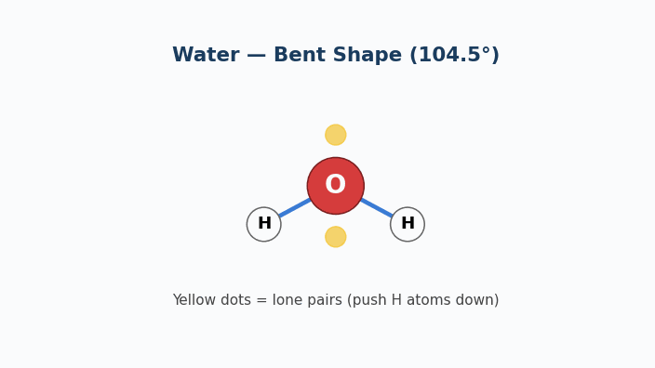
Animation — VSEPR: Water's Bent Shape
Two lone pairs (yellow) push the H atoms down to a 104.5° bond angle.

Slide 12
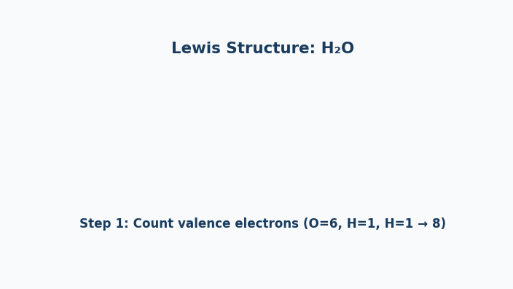
Animation — Lewis Structure of H₂O
Step-by-step build: count valence e⁻ → place atoms → bonds → lone pairs.

Slide 13
CHEMDU · LEVEL 2 · ADVANCED
L2-3: Chemical Bonding (Advanced)
WRAP-UP
Predicting structure from formula
CONCEPT / FORMULA | WHAT IT MEANS / USE
Lewis structure | 5-step method to draw any molecule
VSEPR theory | Electron groups repel → set shape
ΔEN < 0.4 | Non-polar bond
ΔEN 0.4 – 1.7 | Polar covalent bond
ΔEN > 1.7 | Ionic bond
Symmetry | Decides if a polar-bonded molecule is polar
chemdu.org
Slide 11 / 11

