Slide 1
CHEMDU · COMMUNITY CHEMISTRY · LEVEL 2 ADVANCED
LECTURE 2
Periodic Table (Advanced)
Three trends that explain everything
chemdu.org | An advanced module

Slide 2
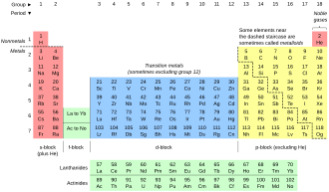
CHEMDU · LEVEL 2 · ADVANCED
L2-2: Periodic Table (Advanced)
OPENING
Why are some elements so different?
▸ A potassium pill is safe — pure potassium metal explodes.
▸ Sodium and potassium are in the same column. Why is K MORE reactive?
▸ Three trends explain it: atomic size, ionization energy, electronegativity.
▸ After today, you can predict an element's behavior just from its position.
Potassium pill vs. potassium metal
chemdu.org
Slide 2 / 12

Slide 3
CHEMDU · LEVEL 2 · ADVANCED
L2-2: Periodic Table (Advanced)
REVIEW
Level 1 essentials
▸ Periodic table: rows = periods, columns = groups (families)
▸ Same group = same valence electrons = similar behavior
▸ Group 1 = alkali metals (1 valence e⁻) — very reactive
▸ Group 17 = halogens (7 valence e⁻) — very reactive
▸ Group 18 = noble gases (8 valence e⁻ = full) — non-reactive
chemdu.org
Slide 3 / 12

Slide 4
CHEMDU · LEVEL 2 · ADVANCED
L2-2: Periodic Table (Advanced)
VALENCE ELECTRONS
Easy lookup by group
Group | Valence | Reactivity | Example
1 | 1 | Very reactive | Na, K, Cs
2 | 2 | Reactive | Mg, Ca
13–16 | 3–6 | Variable | Al, C, N, O
17 | 7 | Very reactive | F, Cl, Br
18 | 8 | Inert | He, Ne, Ar
chemdu.org
Slide 4 / 12

Slide 5
CHEMDU · LEVEL 2 · ADVANCED
L2-2: Periodic Table (Advanced)
📐 TREND 1
Atomic radius
ACROSS A PERIOD (LEFT → RIGHT)
DOWN A GROUP (TOP → BOTTOM)
SHRINKS ACROSS A PERIOD (MORE PROTONS PULL ELECTRONS IN)
Na
Mg
Al
Si
P
S
Cl
Ar
186 pm
160
143
117
110
104
99
71
chemdu.org
Slide 5 / 12

Slide 6
CHEMDU · LEVEL 2 · ADVANCED
L2-2: Periodic Table (Advanced)
📐 TREND 2
Ionization energy
ACROSS A PERIOD
DOWN A GROUP
RISES ACROSS A PERIOD (HARDER TO REMOVE TIGHTLY HELD E⁻)
Na
Mg
Al
Si
P
S
Cl
Ar
496 kJ/mol
738
578
786
1012
999
1251
1521
chemdu.org
Slide 6 / 12

Slide 7
CHEMDU · LEVEL 2 · ADVANCED
L2-2: Periodic Table (Advanced)
📐 TREND 3
Electronegativity (Pauling scale)
ACROSS A PERIOD
DOWN A GROUP
RISES ACROSS A PERIOD (SMALL ATOMS = GREEDY FOR ELECTRONS)
F
O
N
Cl
C
H
Na
Cs
4.0
3.5
3.0
3.0
2.5
2.1
0.9
0.7
chemdu.org
Slide 7 / 12

Slide 8
CHEMDU · LEVEL 2 · ADVANCED
L2-2: Periodic Table (Advanced)
REACTIVITY RULES
Two opposite directions
▸ $RED{Metals: reactivity INCREASES going DOWN a group}
▸ K is more reactive than Na (lower in Group 1)
▸ Cs > Rb > K > Na > Li
▸ $BLU{Non-metals: reactivity INCREASES going UP a group}
▸ F is more reactive than Cl (higher in Group 17)
▸ F > Cl > Br > I
chemdu.org
Slide 8 / 12

Slide 9
CHEMDU · LEVEL 2 · ADVANCED
L2-2: Periodic Table (Advanced)
✦ WORKED EXAMPLE 1
Compare reactivity: Na vs. K
?
Both are in Group 1 (alkali metals). Which is more reactive in water?
1
Both have 1 valence electron — easy to lose.
2
K is BELOW Na in Group 1 — bigger atom, more shells.
3
K's outer electron is FARTHER from the nucleus.
4
Less attraction → easier to lose → more reactive.
5
∴ K reacts MORE violently with water than Na.
✦ ANSWER
K is more reactive
chemdu.org
Slide 9 / 12

Slide 10
CHEMDU · LEVEL 2 · ADVANCED
L2-2: Periodic Table (Advanced)
✦ WORKED EXAMPLE 2
Compare reactivity: Cl vs. I
?
Both are halogens (Group 17). Which is more reactive?
1
Halogens want to GAIN one electron.
2
Cl is ABOVE I in Group 17 — smaller atom.
3
Cl's nucleus is closer to the incoming electron — stronger pull.
4
∴ Cl is more reactive than I.
5
(Same logic: F > Cl > Br > I)
✦ ANSWER
Cl is more reactive
chemdu.org
Slide 10 / 12

Slide 11
CHEMDU · LEVEL 2 · ADVANCED
L2-2: Periodic Table (Advanced)
TRENDS SUMMARY
Three rules that explain everything
Trend | Across period → | Down group ↓ | Why
Atomic radius | Decreases | Increases | More protons pull (across); more shells (down)
Ionization energy | Increases | Decreases | Tighter pull (across); farther outer e⁻ (down)
Electronegativity | Increases | Decreases | Same as ionization energy
chemdu.org
Slide 11 / 12

Slide 12
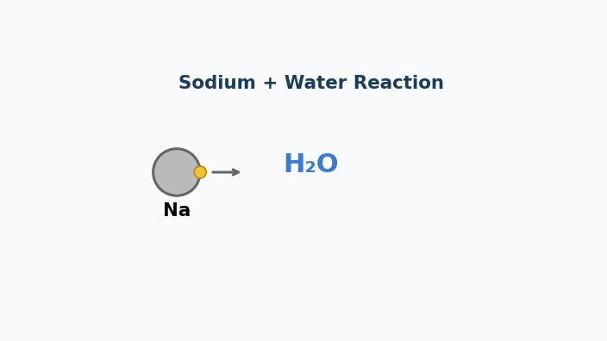
Animation — Why Sodium Explodes in Water
Sodium hands its valence electron to water → Na⁺ + free electron + heat.

Slide 13
CHEMDU · LEVEL 2 · ADVANCED
L2-2: Periodic Table (Advanced)
WRAP-UP
Trends as predictors
CONCEPT / FORMULA | WHAT IT MEANS / USE
Atomic radius | Smaller across; bigger down
Ionization energy | Higher across; lower down
Electronegativity | Higher across; lower down
Metals: reactivity ↑ DOWN | Cs > Rb > K > Na
Non-metals: reactivity ↑ UP | F > Cl > Br > I
chemdu.org
Slide 12 / 12

