Slide 1
CHEMDU · COMMUNITY CHEMISTRY · LEVEL 2 ADVANCED
LECTURE 1
Atomic Structure (Advanced)
Isotopes, atomic mass, and the math of half-life
chemdu.org | An advanced module

Slide 2
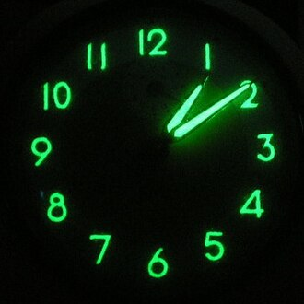
CHEMDU · LEVEL 2 · ADVANCED
L2-1: Atomic Structure (Advanced)
OPENING
Three radioactive things in plain sight
▸ Banana — contains potassium-40 (β-emitter, harmless dose).
▸ Smoke detector — contains americium-241 (α-emitter, sealed).
▸ Table salt — chlorine has TWO common isotopes (³⁵Cl 76%, ³⁷Cl 24%).
▸ Today: the math behind these — average atomic mass, half-life, decay.
Banana · smoke detector · salt
chemdu.org
Slide 2 / 12

Slide 3
CHEMDU · LEVEL 2 · ADVANCED
L2-1: Atomic Structure (Advanced)
REVIEW
Quick Level 1 refresher
▸ Atom = nucleus (protons + neutrons) + electrons in shells
▸ Atomic number Z = number of protons (defines the element)
▸ Mass number A = protons + neutrons (defines the isotope)
▸ Electrons orbit; protons + neutrons are stuck together (strong force)
chemdu.org
Slide 3 / 12

Slide 4
CHEMDU · LEVEL 2 · ADVANCED
L2-1: Atomic Structure (Advanced)
⚛ NOTATION
AZX notation: read it like coordinates
MASS NUMBER →
14
C
(protons + neutrons)
← ELEMENT
ATOMIC NUMBER →
6
(number of protons)
COMMON EXAMPLES
12/6 C
13/6 C
14/6 C
35/17 Cl
Stable carbon (98.9%)
Stable (1.1%)
Radioactive (trace)
Stable (76%)
chemdu.org
Slide 4 / 12

Slide 5
CHEMDU · LEVEL 2 · ADVANCED
L2-1: Atomic Structure (Advanced)
CHLORINE IN SALT
Two stable isotopes — average mass = 35.45
Isotope | Mass (amu) | Abundance | Contribution
³⁵Cl | 34.97 | 75.78% | 34.97 × 0.7578 = 26.51
³⁷Cl | 36.97 | 24.22% | 36.97 × 0.2422 = 8.95
Total | — | 100% | 35.45 amu ← average atomic mass
chemdu.org
Slide 5 / 12

Slide 6
CHEMDU · LEVEL 2 · ADVANCED
L2-1: Atomic Structure (Advanced)
✦ WORKED EXAMPLE 1
Average atomic mass of chlorine
?
Two stable isotopes: ³⁵Cl (34.97 amu, 75.78%) and ³⁷Cl (36.97 amu, 24.22%). What is the average atomic mass?
1
avg = Σ (mass × fraction)
2
avg = 34.97 × 0.7578 + 36.97 × 0.2422
3
avg = 26.5077 + 8.9522
4
avg = 35.46 amu
5
(matches the periodic table value of 35.45 amu)
✦ ANSWER
35.46 amu
chemdu.org
Slide 6 / 12

Slide 7
CHEMDU · LEVEL 2 · ADVANCED
L2-1: Atomic Structure (Advanced)
✦ WORKED EXAMPLE 2
Average atomic mass of potassium (banana K)
?
Three isotopes: ³⁹K (38.964 amu, 93.26%), ⁴⁰K (39.964 amu, 0.012%), ⁴¹K (40.962 amu, 6.73%).
1
avg = Σ (mass × fraction)
2
avg = 38.964 × 0.9326 + 39.964 × 0.00012 + 40.962 × 0.0673
3
avg = 36.341 + 0.0048 + 2.7567
4
avg ≈ 39.10 amu
✦ ANSWER
39.10 amu
chemdu.org
Slide 7 / 12

Slide 8
CHEMDU · LEVEL 2 · ADVANCED
L2-1: Atomic Structure (Advanced)
STABILITY
Why some isotopes decay
▸ Stable atoms have neutron-to-proton ratio (n/p) ≈ 1 for small elements
▸ Heavier elements need slightly more neutrons (n/p > 1) to stay stable
▸ If the ratio is wrong, the atom is RADIOACTIVE — it decays
▸ Carbon-14 has n/p = 8/6 = 1.33 — slightly too many neutrons → β decay
▸ Decay produces α (²He), β (e⁻), or γ (photon) radiation
chemdu.org
Slide 8 / 12

Slide 9
CHEMDU · LEVEL 2 · ADVANCED
L2-1: Atomic Structure (Advanced)
HALF-LIFE
Time for half a sample to decay
▸ Half-life (t₁/₂) is constant for each isotope
▸ Carbon-14: t₁/₂ = 5,730 years
▸ After 1 half-life: 50% remains. After 2: 25%. After 3: 12.5%.
▸ Doesn't depend on amount or temperature — purely nuclear
▸ Used in radiocarbon dating, medical imaging, smoke detectors
chemdu.org
Slide 9 / 12

Slide 10
CHEMDU · LEVEL 2 · ADVANCED
L2-1: Atomic Structure (Advanced)
✦ WORKED EXAMPLE 3
Carbon-14 dating
?
A bone fragment has 12.5% of original ¹⁴C remaining. How old is it? (t₁/₂ = 5,730 yr)
1
Remaining = Initial × (1/2)ⁿ
2
0.125 = (1/2)ⁿ
3
n = 3 (because (1/2)³ = 0.125)
4
Age = 3 half-lives × 5,730 yr/half-life
5
Age = 17,190 years
✦ ANSWER
17,190 years
chemdu.org
Slide 10 / 12

Slide 11
CHEMDU · LEVEL 2 · ADVANCED
L2-1: Atomic Structure (Advanced)
HOUSEHOLD ISOTOPES
Where they live and what they do
Isotope | Decay | Half-life | Where
¹⁴C | β⁻ | 5,730 yr | Living tissue, dating
⁴⁰K | β⁻/EC | 1.25 × 10⁹ yr | Bananas, body, soil
²⁴¹Am | α | 432 yr | Smoke detectors
²²⁶Ra | α | 1,600 yr | Old radium watch dials
²²²Rn | α | 3.8 days | Basement air
chemdu.org
Slide 11 / 12

Slide 12
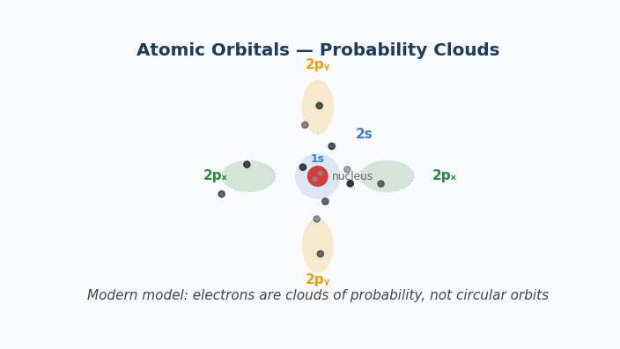
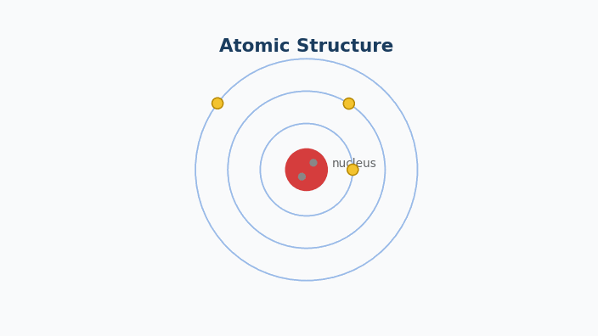
Animation — Atomic Orbitals (Quantum Model)
Three electron shells around a nucleus. Each electron orbits at its own radius.

Slide 13
CHEMDU · LEVEL 2 · ADVANCED
L2-1: Atomic Structure (Advanced)
WRAP-UP
Key concepts and formulas
CONCEPT / FORMULA | WHAT IT MEANS / USE
avg = Σ(mass × fraction) | Weighted average atomic mass
t₁/₂ | Half-life — constant per isotope
Remaining = N₀ × (½)ⁿ | How much is left after n half-lives
n = log(Initial/Remaining) / log(2) | Solve for number of half-lives
¹⁴ ₆C | Mass / atomic / element notation
chemdu.org
Slide 12 / 12

